Slide 1
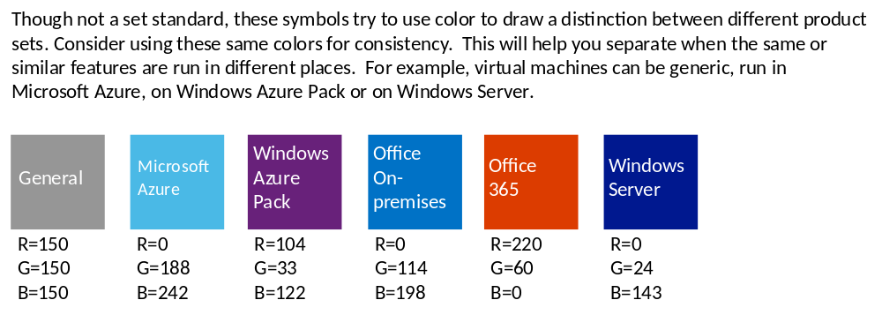

Slide 2






General
code file
automation
script file
Windows PowerShell file
Unidentified Feature Object (UFO)
file type 1
file type 2

Slide 3










Windows Azure General
load balancer (generic)
Microsoft
Azure
certificate
management certificate
Azure load balancer
Azure SDK
Azure load balancer (stretchable)
Azure subscription
service certificate
autoscale
Azure alert

Slide 4





















Compute – Web Sites and Cloud Services
Azure Web Site
cloud service
.csdef
cloud services
definition
MySQL
database
web role
.cscfg
cloud service configuration
Team Foundation Service
or Visual Studio Online
web roles
worker role
.cspkg
service package
Git repository
worker roles
GitHub code
.wadcfg diagnostics config
service endpoint
DropBox
code source
Affinity Group
.rdp
remoting file
BitBucket
code source
Codeplex code source
Startup task

Slide 5







Compute – Web Sites and Cloud Services
Virtual Machines (the feature)
virtual machine
VHD
VHD data disk
availability set
availability set
Azure Mobile Services

Slide 6












Data Services
storage blob
Azure SQL Database
SQL database (generic)
storage table
SQL Data Sync
database (generic)
storage queue
SQL Reporting
(deprecated)
HDInsight (Hadoop)
Backup Service
StorSimple

Slide 7












App Services
Azure Cache
Service Bus (Feature)
Notification Topic
Content Delivery Network (CDN)
Service Bus Relay
Notification Hub
Service Bus Queue
BizTalk Services
Azure Active Directory
Service Bus Topic
Access Control
Multi-Factor Authentication
Media Services

Slide 8



Networking
Virtual network
Traffic Manager
Virtual Network
Content Delivery Network (CDN)
Express Route

Slide 9

Marketplace / Store
Marketplace / Store

